Slide 1
It brings news and current events to our fingertips and allows children to expand their horizons.
Online games can enhance teamwork and creativity.
Using technology is proven to improve both visual intelligence and hand-eye coordination.
The internet allows children to access education and encourages them to engage with learning at home and school.
It is a source of fun and entertainment.
Online Safety Information
February 2020

Slide 2
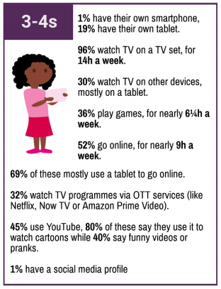
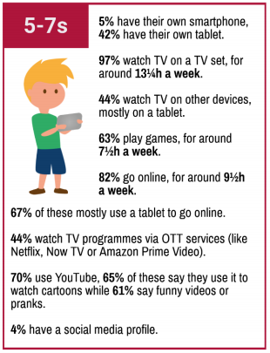

Slide 3
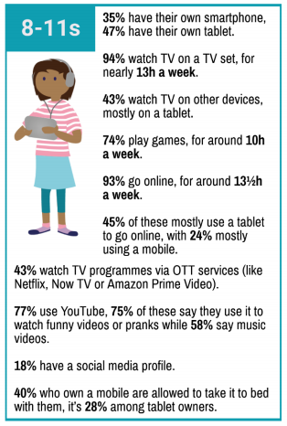
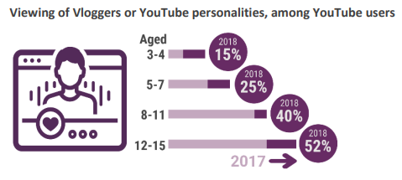

Slide 4
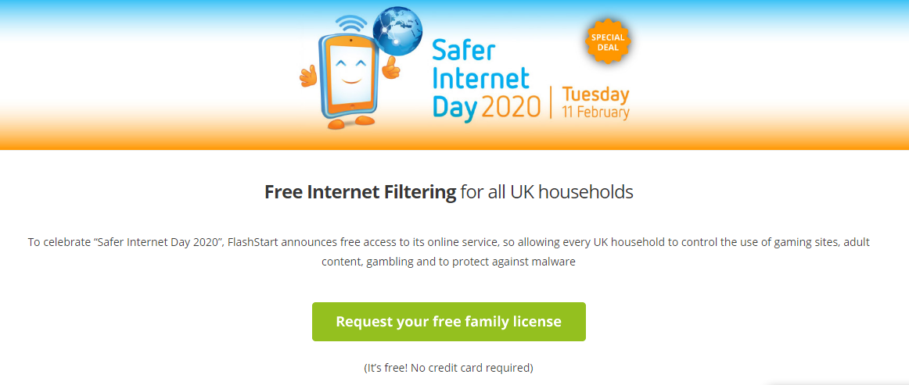
https://flashstart.com/saferinternetday/

Slide 6
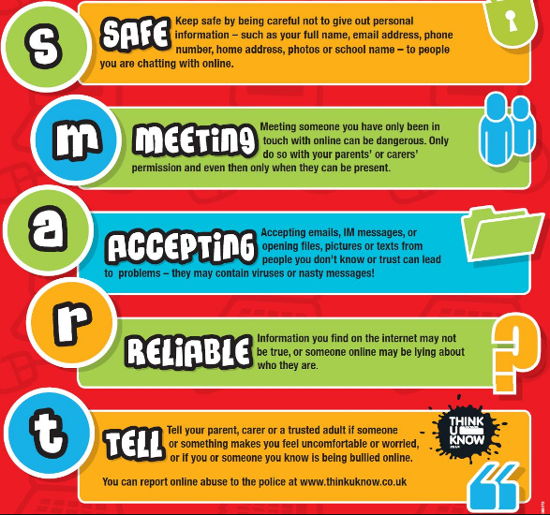
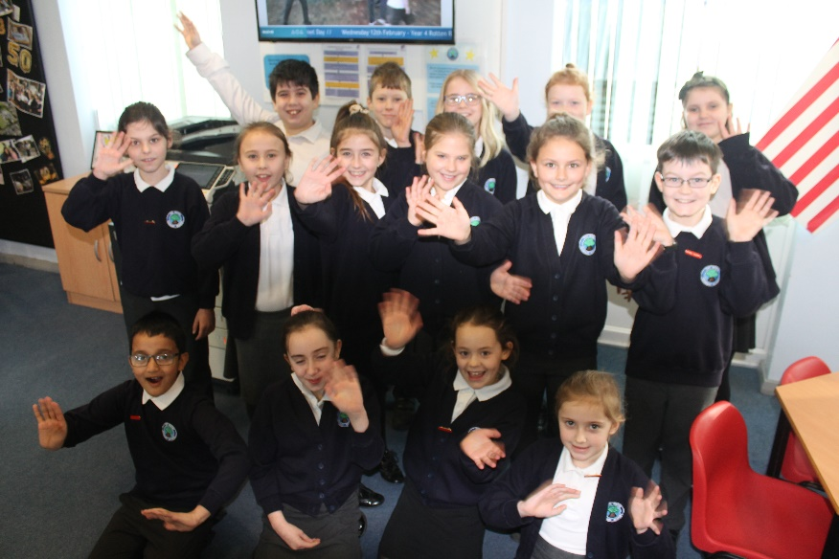
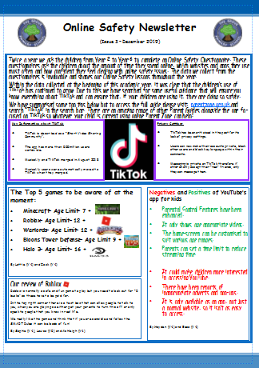
Online Safety at The Grove!
The Grove Digital Leaders
Our Online Safety Newsletter is sent out twice a year with useful attachments.

Slide 7
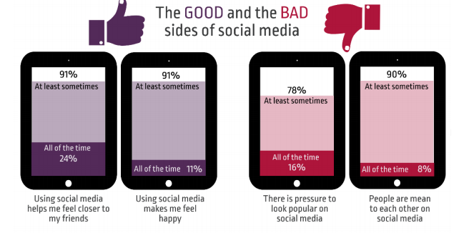
Online reputation/ Social media
The NSPCC website has great advice on how to be “Share Aware”,
Net-aware.org.uk can tell you everything you need to know about age restrictions and possible content on all social media sites that your child could be using.
Internetmatters.com has fantastic advice on how to manage social media use and risks you should be looking out for as a parent.

Slide 8
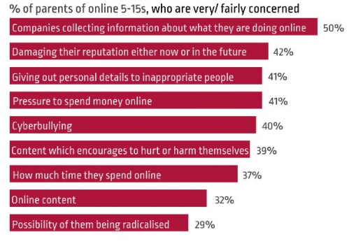
Cyberbullying
Cyberbullying is the use of technology to bully an individual or a group with the intent to cause harm.
The intended harm may be social, psychological and, in extreme cases, physical.
Cyberbullying can cause fear, withdrawal, shame, guilt, loneliness or depression.
Create a family contract to discuss possible risks and make agreements about how to avoid them together.
Communicate as openly as possible about what your child is doing online. This will make them feel like they can tell you if something does go wrong.
Set time restrictions to ensure you have control of when and how often your child is online.

Slide 9
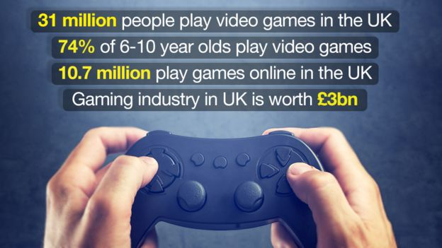
Gaming
To consider- are you comfortable with the content of the game your child is playing?
To consider- do you know who your child is interacting with in their online gaming world?
To consider- is your child’s interest in gaming effecting other areas of their life? i.e. school work, socialising…
The biggest issue for parents is that online gaming is changing all of the time. Staying informed is the best way to protect your child in the online gaming world.
www.commonsensemedia.com is an amazing tool that you can use.

Slide 10
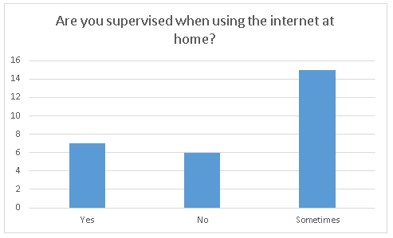
What can you do at home?
Be aware of what you child is doing online.
Where do they access the internet?
Which parental controls do you have?
How often do you discuss online safety issues?
If you wouldn’t be comfortable with it offline don’t allow it online.
Is your child only speaking to people they know in real life?
Do you regularly check what they are doing online?
Seek advice.
Contact school if there is an issue online that may effect your child in school or have links to their life at school.
Use the range of websites and information that is available to give you guidance and advice.
Use helplines set up by the NSPCC and Childline to seek advice and support if something may have gone wrong.

Slide 11
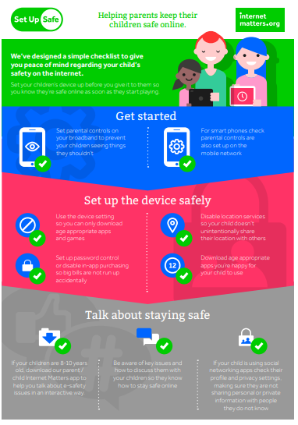
Please take home some of these useful guides to help you begin conversations about some of the more challenging Online Safety issues with your children.
All of these guides, and this presentation, will also be available on our school website.

